Slide 1
ACTIVITIES FOR THE ENVIRONMENTAL MANAGEMENT OF THE QUEBRADA LA MOSCA, MUNICIPALITY OF RIONEGRO AND GUARNE- ANTIOQUIA
Rionegro Rotary Club
2021
http://www.rotary.org

Slide 2
The Rionegro Rotary Club interested in the principles of conservation and protection of the environment, which generates quality of life in the inhabitants of the Oriente subregion, intends to help raise awareness and generate actions that serve to improve, control and mitigate the current conditions that affect this water resource and its environment. So then begins the development of a proposal that according to current needs becomes a project that will achieve the environmental management of a basin (La Mosca stream).

Slide 3
General purpose
Implement actions that allow the environmental management of the La Mosca stream basin, to recover the natural resources of the area and enable awareness and empowerment of the communities.

Slide 4
Activities
Carry out a diagnosis on the real state of the La Mosca stream.
Raise awareness and train the community in the efficient use and saving of water, in conservation of protection areas and proper management of liquid and solid waste dumping, on the ground and directly at the water source.
Reforest with native species and make isolation in areas of retreat and protection of the basin.
Formulate a citizen oversight agreement with respect to the natural resources that make up the environmental ordering of the water source. Involve existing companies and industries to carry out permanent work with the neighboring community and educational institutions in the area, through activities of their social responsibility.

Slide 5
Expected results
Mitigation and prevention of environmental impacts, which may be generated by the mixed Industrialization and Urbanism activity in the future.
Empowered communities of their territories, faithfully overseers of natural resources, committed to future generations and aware of the value of nature.
A work that will serve as the first step in the development and possibility of due environmental management from the source of the stream to the mouth.

Slide 6
The water source that we all want ...

Slide 7
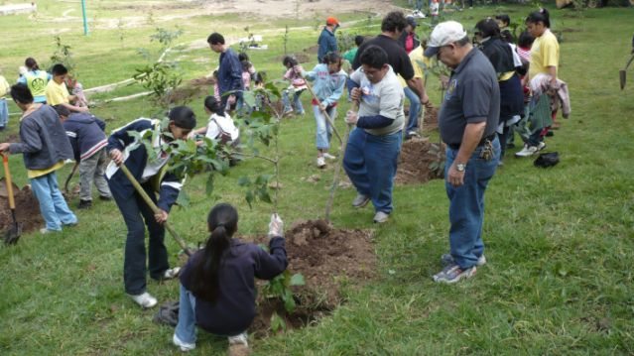
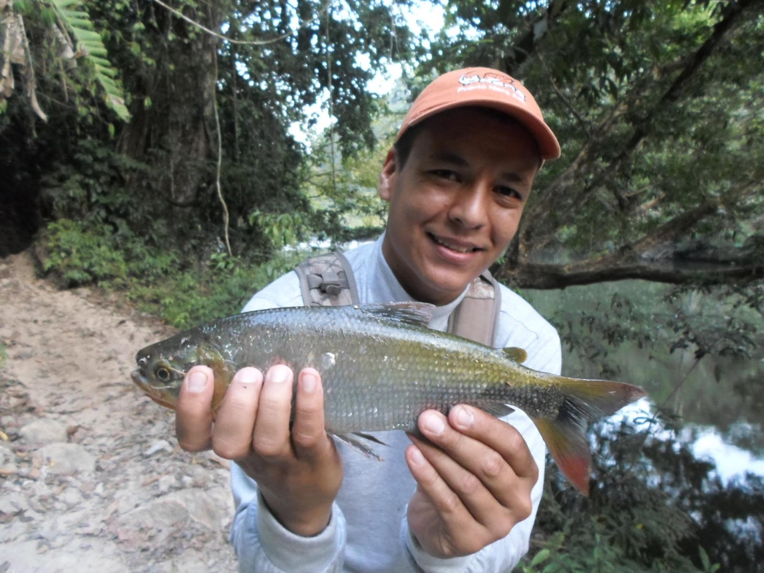
ENVIRONMENTAL MANAGEMENT ACTIONS
Reforesting and fish, but with community commitment

Slide 8
Transformations and supports :
It will help transform:
Due control in the establishment of new land uses and the general development of the region.
Recover activities typical of the area, in reference to water resources, such as tourism, fishing and the contemplation of healthy spaces with great environmental wealth.
Improve the quality of the water that supplies agricultural activities, still existing in the area and for other domestic uses.

Slide 9
Strengths on which it relies:
The entities that will be involved with the project, such as competent authorities, educational institutions, the Rotary Club Corporation that guarantees social work rooted in the region and empowered by the communities and through community and industrial or business agreements (advocating to social responsibility with the region).
The educational sector represented by the Universidad Católica de Oriente and the competent entities such as the environmental authority of the region, the Autonomous Corporation - CORNARE and the Municipal Administration.

Slide 10
